Slide 1
Analysis of Pediatric Patients Referred to Neuro-ophthalmology Clinic at a Tertiary Eye Hospital
Dr. Kirandeep Kaur
DNB Ophthalmology, FPOS
The authors have no Financial Interests

Slide 2
Introduction
Neuro-ophthalmic disorders constitute an important cause of visual impairment and ocular morbidity
Signify the existence of an ocular, extra-ocular, intracranial or systemic disease
Dhiman et al, found that Neuro-ophthalmic disorders constituted 5% of all referrals to the center¹
Pediatric referral to neuro-ophthalmology – showed a high yield for diagnosing neurological disease and often uncovers intracranial abnormalities²
^{1.} Dhiman R, Singh D, Gantayala SP, Ganesan VL, Sharma P, et al. Neuro-ophthalmology at a Tertiary Eye Care Centre in India. J Neuroophthalnol 38:308-311.
^{2.} Tirpack AR, Vanner EA, Sheheitli H, Mendoza CE, Grajewski A, Chang TC. Neuro-ophthalmic Disease in Pediatric Glaucoma Practice. J Glaucoma. 2020 Feb;29(2):117-123.

Slide 3
Aims and Methods
AIM
STUDY PROTOCOL
To analyse the patterns and clinical characteristics of patients referred to Neuro-ophthalmology department
Inclusion criteria: Patients evaluated by both pediatric and Neuro-ophthalmology departments
1st Jan to 30th June 2019
STUDY DESIGN
Retrospective Institution based review of medical records
88 pediatric patients
Records were reviewed for: Visual acuity, Clinical examination findings, Demographic, Neuroimaging and Diagnosis
SETTING
Aravind Eye Hospital, Pondicherry

Slide 4

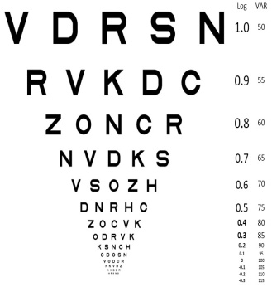
Results
Ratio: 1:1.3
Mean (SD) BCVA = 0.56 (+/- 0.83)

Slide 5
Manifestations range from life-threatening intracranial or systemic disease to minor congenital anomalies
1
Responsibility of clinicians to determine appropriate management, avoiding unnecessary investigations and treatment
2
Discussion
Most common cause for referrals in our study was optic nerve pathologies followed by mononeuropathies
3
Most of the conditions if diagnosed in acute stages can be managed well
4
Incorrect referral rate in our study was 11.36%; almost similar to 16% reported earlier from a tertiary centre in India¹
5
1. Dhiman R, Singh D, Gantayala SP, Ganesan VL, Sharma P, et al. Neuro-ophthalmology at a Tertiary Eye Care Centre in India. J Neuroophthalnol 38:308-311.

Slide 6
Conclusion
Male:female ratio was 1.3:1
22 patients were advised imaging – 7 had abnormalities
Prompt investigations and meticulous management can be vision/life saving
Infants formed the major proportion of patients (26.2%)
Most common pathologies were Optic nerve (23.9%) related followed by Mononeuropa-
thies (20.5%)

Slide 7


